Slide 1

Logistics Optimization for Delivery Routes – Flipkart
By Akshay Jariyal (1st Aug)

Slide 2

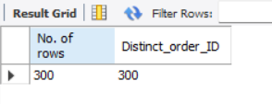
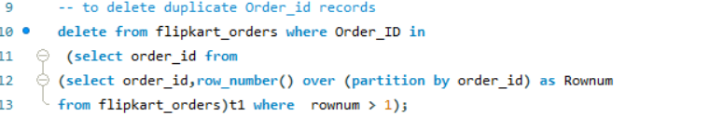
Task 1: Data Cleaning & Preparation
● Identify and delete duplicate Order_ID records.

Slide 3
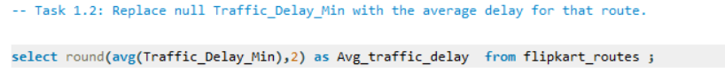
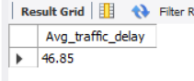
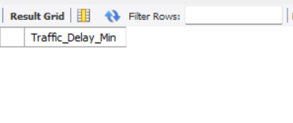
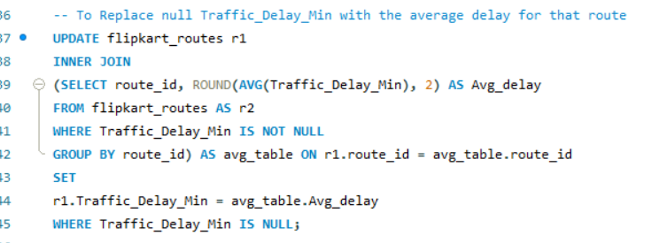
Replace null Traffic_Delay_Min with the average delay for that route.

Slide 4
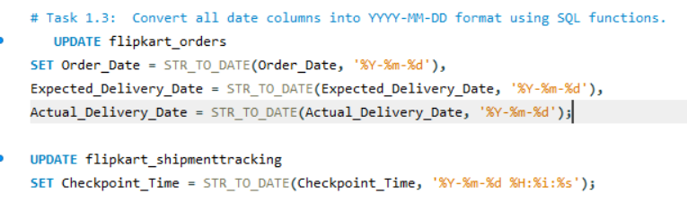
Convert all date columns into YYYY-MM-DD format using SQL functions.

Slide 5
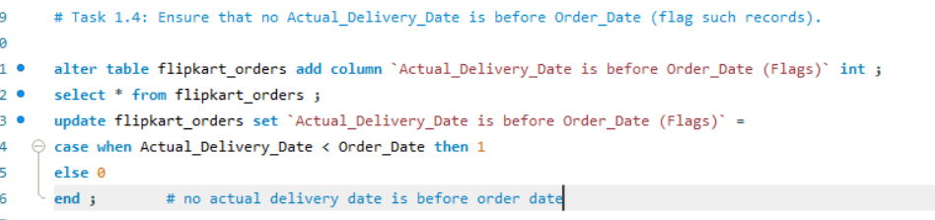
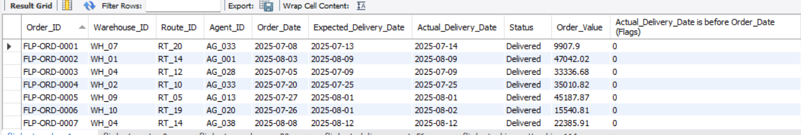
Ensure that no Actual_Delivery_Date is before Order_Date (flag such records).

Slide 6
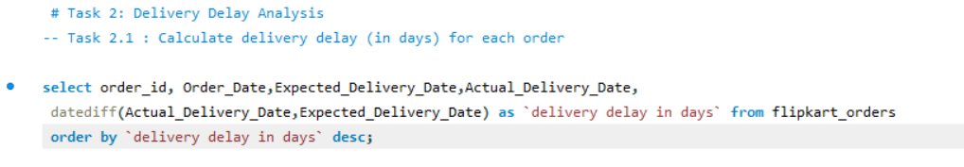
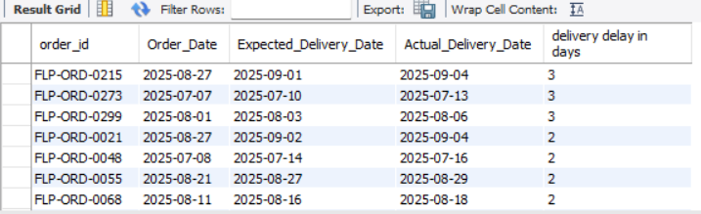
Task 2: Delivery Delay Analysis
● Calculate delivery delay (in days) for each order

Slide 7
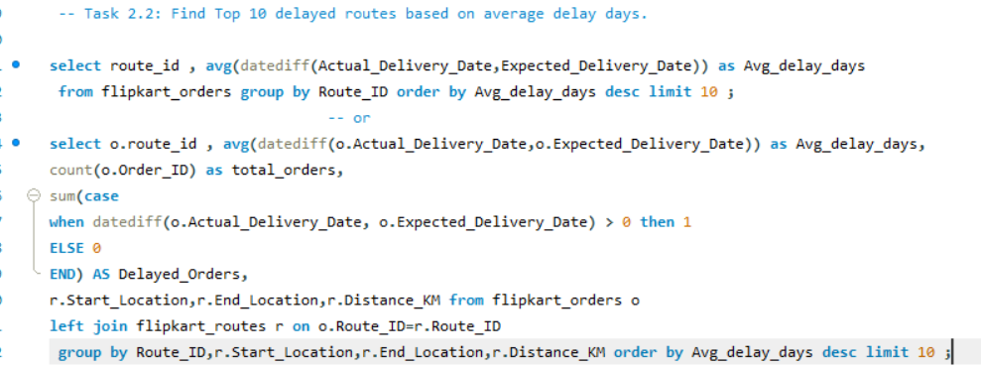
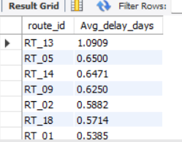
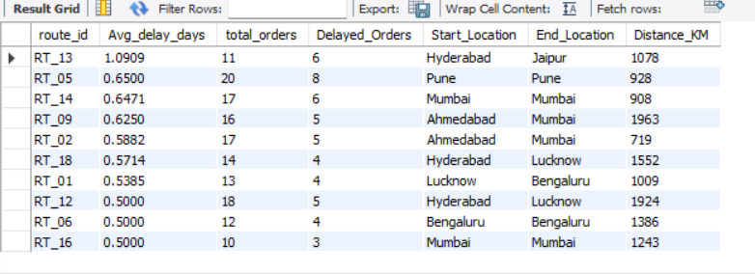
Find Top 10 delayed routes based on average delay days.

Slide 8
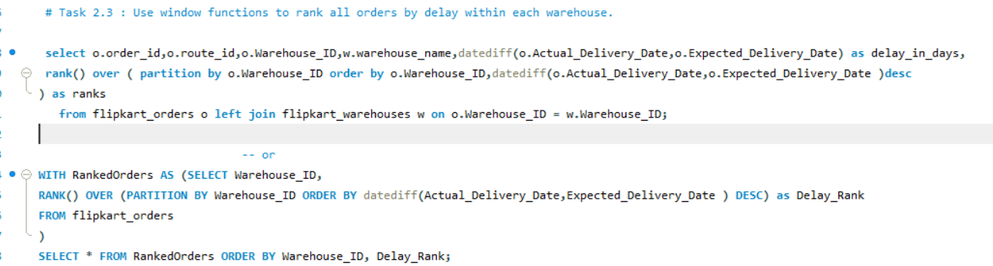
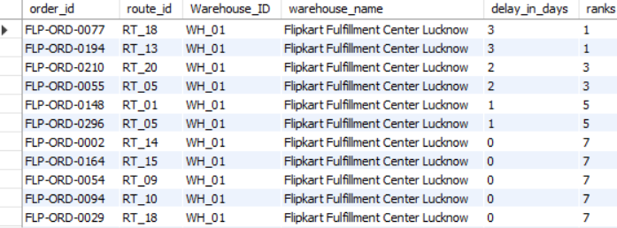
Use window functions to rank all orders by delay within each warehouse.

Slide 9
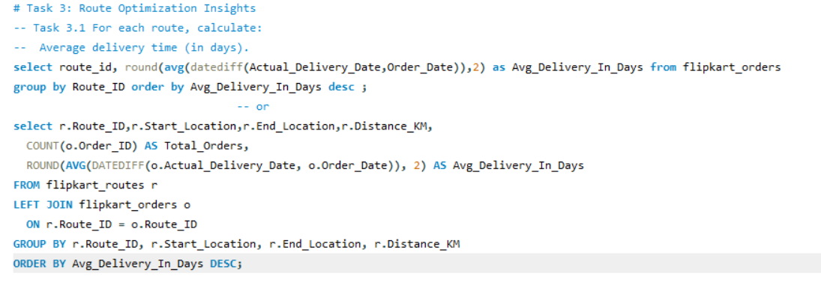
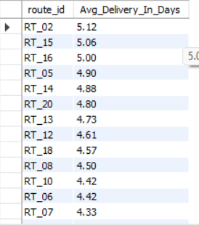
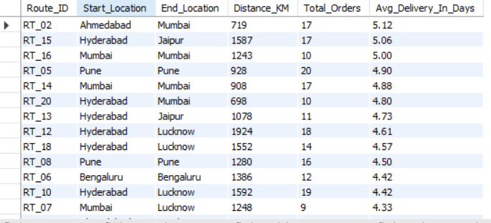
Task 3: Route Optimization Insights
● For each route, calculate: ○ Average delivery time (in days)

Slide 10
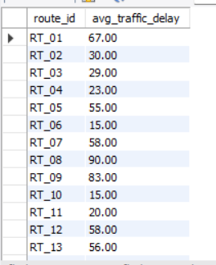
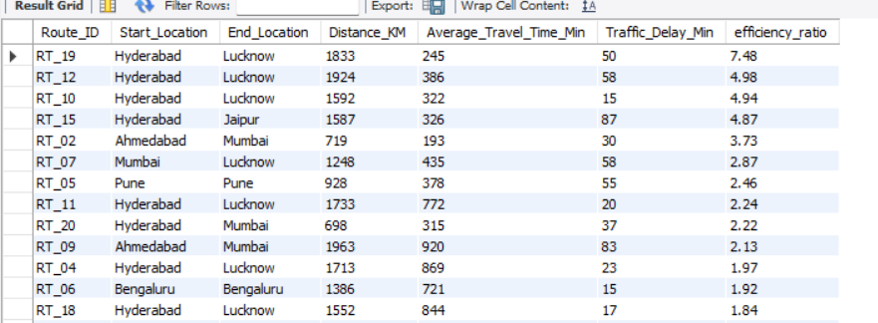
Average traffic delay.
Distance-to-time efficiency ratio: Distance_KM / Average_Travel_Time_Min.

Slide 11
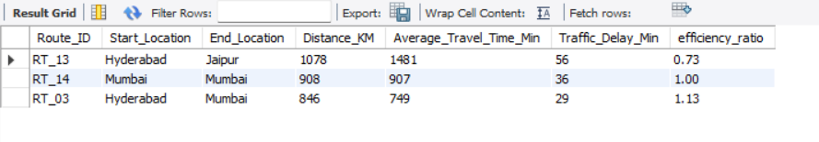
Identify 3 routes with the worst efficiency ratio.

Slide 12
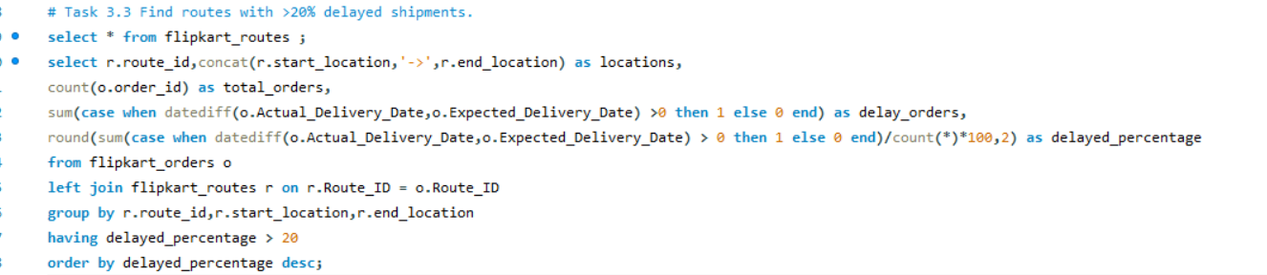
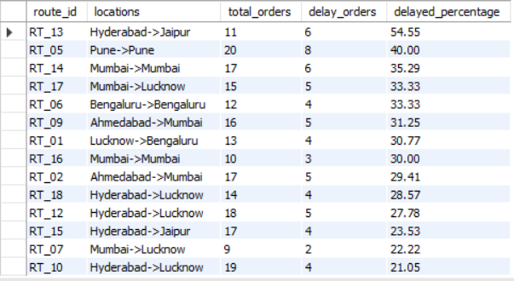
Find routes with >20% delayed shipments.

Slide 13
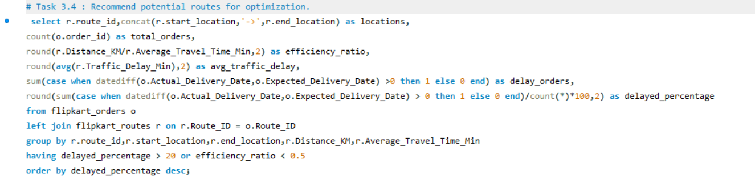
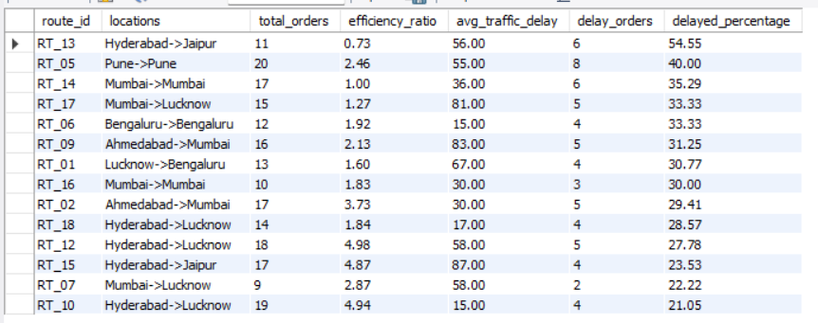
Recommend potential routes for optimization.

Slide 14
Recommend potential routes for optimization.
Focus first on improving the Hyderabad to Jaipur, Pune to Pune, and Mumbai to Mumbai routes, as these have delay rates above 35%. These bottlenecks may be causing significant customer dissatisfaction.
For routes with high traffic delays (like Mumbai to Lucknow and Ahmedabad to Mumbai), try to schedule deliveries during off-peak hours or investigate alternate pathways to avoid congestion.
Where efficiency ratio is low, like Hyderabad to Jaipur with just 0.73, consider breaking the route into smaller segments or reassigning faster delivery resources.
Review which drivers or delivery teams are assigned to the most-delayed routes; targeted training and support may quickly boost their performance.
Keep monitoring delay rates for all routes, but especially the top 5 with the highest late percentages, so small improvements can be quickly recognized and scaled.
By acting on these points, you’ll not only cut delays but also improve customer satisfaction and make your entire delivery system stronger and more responsive to real-world challenges

Slide 15
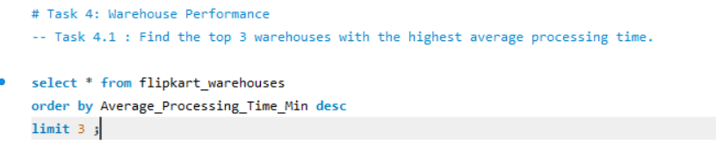
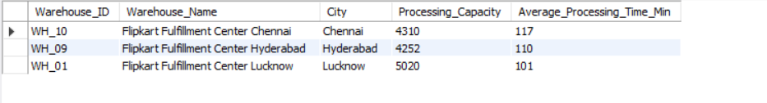
Task 4: Warehouse Performance
● Find the top 3 warehouses with the highest average processing time

Slide 16
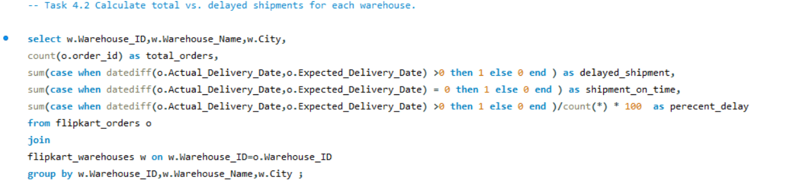
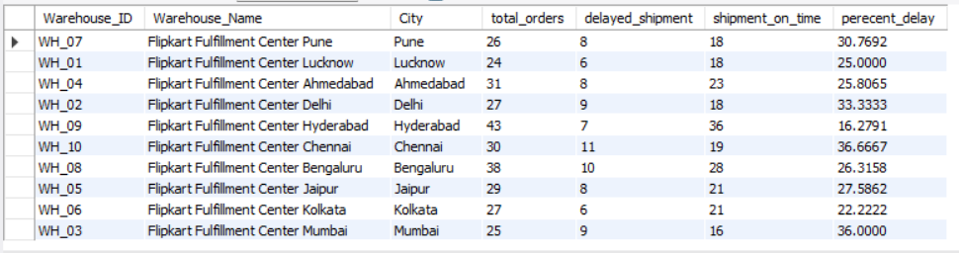
Calculate total vs. delayed shipments for each warehouse

Slide 17
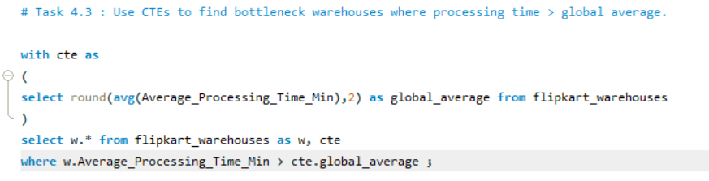
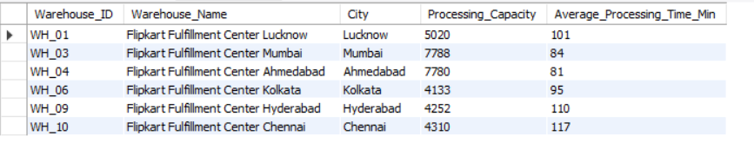
Use CTEs to find bottleneck warehouses where processing time > global average

Slide 18
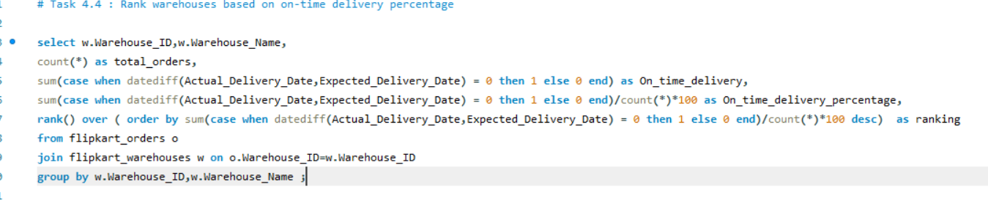
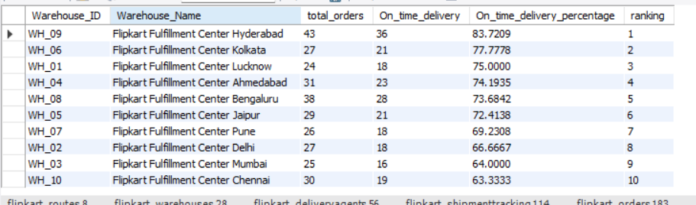
Rank warehouses based on on-time delivery percentage.

Slide 19
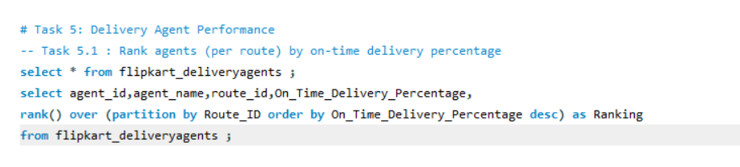
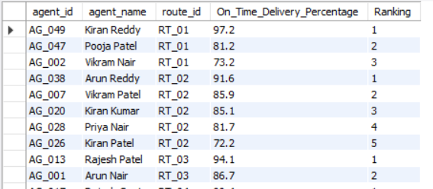
Task 5: Delivery Agent Performance
● Rank agents (per route) by on-time delivery percentage

Slide 20
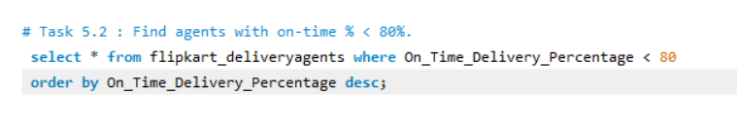
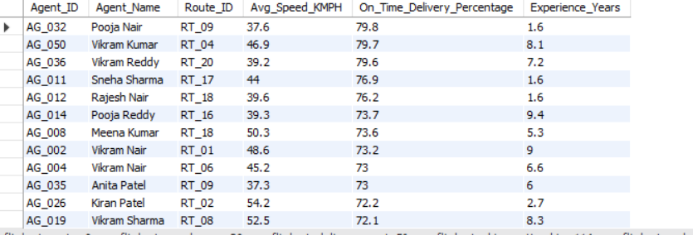
Find agents with on-time % < 80%

Slide 21
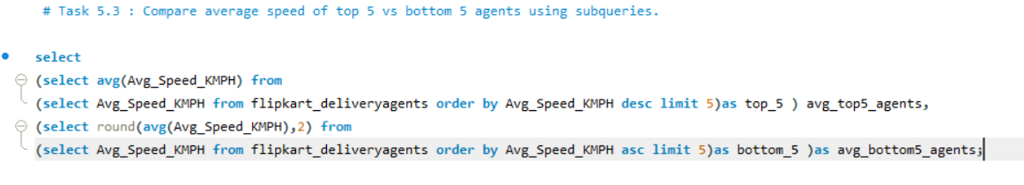
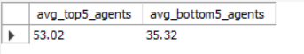
Compare average speed of top 5 vs bottom 5 agents using subqueries.

Slide 22
Suggest training or workload balancing strategies for low performers
Training Strategies:
Skill Gap Analysis: Identify specific skills or knowledge areas where agents lag (e.g., navigation, customer communication, package handling accuracy).
Focused Training Programs: Provide targeted workshops or e-learning modules on weak areas, such as route optimization tools, handling deliveries efficiently, or customer service best practices.
Mentorship and Buddy System: Pair low performers with high-performing agents for hands-on learning and coaching.
Regular Feedback and Reviews: Conduct frequent review sessions to discuss performance issues, progress, and actionable steps.
Simulation Exercises: Use realistic delivery scenarios to practice challenging situations and improve decision-making.
Workload Balancing Strategies:
Route Redistribution: Adjust workloads so low performers get simpler or shorter delivery routes initially to build confidence and success.
Balanced Task Assignment: Mix experienced and novice agents' tasks across routes and shifts for fairness and peer learning.
Performance-Based Incentives: Provide motivation through rewards for gradual improvement and specific goal achievements.
Limit Overload: Avoid overwhelming low-performing agents with too many tasks to reduce errors and delays.
Monitor & Adjust Frequently: Continuously monitor agent performance metrics to dynamically assign workloads matching their capacity.

Slide 23
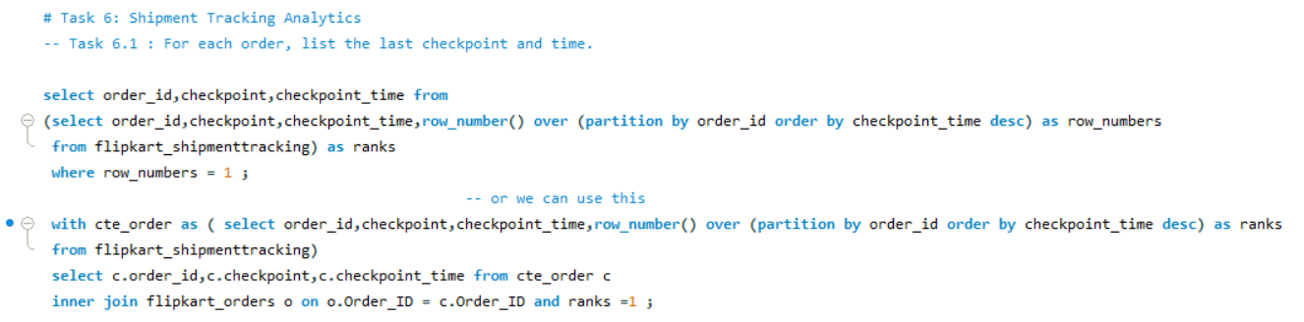
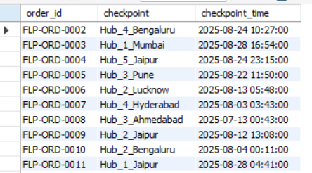
Task 6: Shipment Tracking Analytics
● For each order, list the last checkpoint and time.

Slide 24
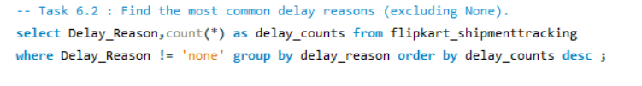
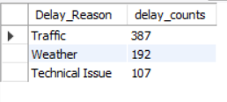
Find the most common delay reasons (excluding None)

Slide 25
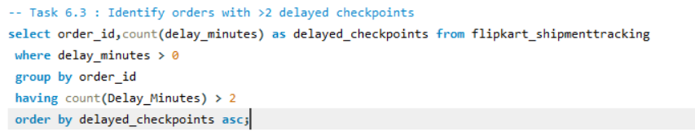
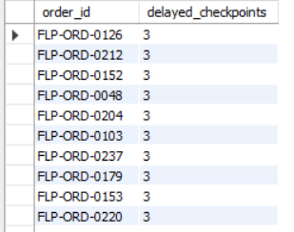
Identify orders with >2 delayed checkpoints

Slide 26
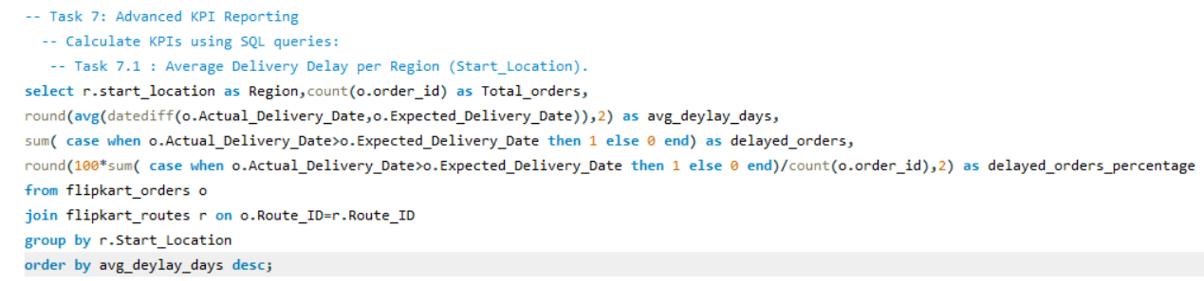
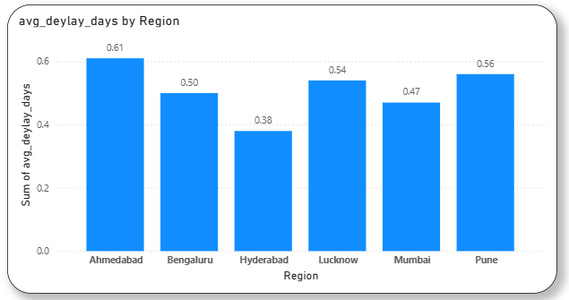
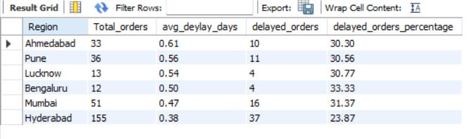
Task 7: Advanced KPI Reporting
Calculate KPIs using SQL queries:
Average Delivery Delay per Region (Start_Location).

Slide 27
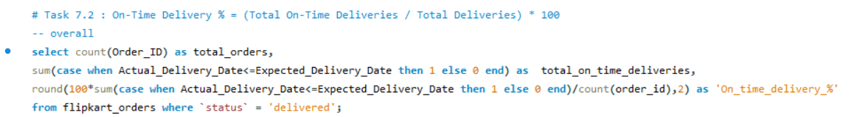




On-Time Delivery % = (Total On-Time Deliveries / Total Deliveries) * 100.

Slide 28



Average Traffic Delay per Route.

Slide 29




Comprehensive Dashboard Query

Slide 30


Slide 31

Video Link
https://drive.google.com/file/d/1hkOCKGanL95hMtxhcYgUx3-U7d947y4S/view?usp=sharing
https://www.loom.com/share/76583580f19b4185b87d64b253d5b5bd

